Slide 1
Assessing the Impact of Economic Factors on Tourist arrivals in Sri Lanka
Aaron Bandara – 20221940
Heashalla Sundaresan – 20230983
Imara Riyal – 20233219
Kusalya Kaluthotage – 20222176
Ranudi Perera – 20233153

Slide 2
Purpose of the project
The purpose of the project is to analyze the influence of economic factors on tourist arrivals in Sri Lanka to provide insights for informed decision-making and strategic planning in the tourism sector.

Slide 3
Problem description
Limited understanding of the impact of economic factors on tourist arrivals in Sri Lanka restricts effective decision-making and strategic planning for sustainable growth in the tourism sector.
Significance of the problem
Understanding the impact of economic factors on tourist arrivals in Sri Lanka is crucial for enabling policymakers and stakeholders to make data-driven decisions, optimize resource allocation, and develop effective strategies that enhance the resilience, competitiveness, and sustainable growth of the country's tourism sector, which is a key driver of economic development.

Slide 4
Background
Tourism is a key contributor to Sri Lanka’s GDP, providing significant employment opportunities and foreign exchange earnings, but it is highly sensitive to economic factors such as exchange rates, inflation, and income levels in source markets.
Limited research on how these economic variables, including their effects on GDP, impact tourist arrivals restricts policymakers and stakeholders from effectively planning and sustaining growth in the tourism sector.

Slide 5
Gap analysis
A time gap occurs as existing research is limited to a specific time frame that does not capture more recent developments, trends, and significant events. In this case, the study ending in 2018 misses the profound changes brought about by global disruptions like the COVID-19 pandemic and the economic crisis during Gotabaya Rajapaksa’s presidential term, which significantly impacted tourism and economic dynamics.
By extending the analysis to include data beyond 2018 and addressing the pandemic's influence, and other significant economic events our study fills this time gap, offering an updated and contextually relevant insight.

Slide 6
Objectives
Main objective
Main objective is to evaluate how various economic factors influence tourist arrivals in Sri Lanka, providing a comprehensive understanding of their impact on the tourism sector.
Specific objectives
To understand the relationship between economic indicators such as real GDP and per capita GDP with tourist arrivals in Sri Lanka.
To assess the role of external economic factors, including exports, imports, and foreign direct investment, on tourism demand.
To analyze how changes in government expenditure on capital and net lending affect tourist arrivals.
To identify the key economic indicators that most significantly impact tourism growth in Sri Lanka.

Slide 7
Research Question
Key Research Questions
How do real GDP and per capita GDP impact tourist arrivals in Sri Lanka?
What is the effect of fluctuations in the official exchange rate on tourism trends?
How do changes in inflation and government expenditure influence the number of tourists visiting Sri Lanka?
To what extent do exports, imports, and foreign direct investment contribute to variations in tourist arrivals?
Which economic factors are the most significant predictors of tourist arrivals?

Slide 8
Methodology
Sources of Data
1. Kaggle : Economy and Rice Production Sri Lanka (1960-2020),
Here we found variables such as GDP , Inflation rates, Imports and GDP per capital.
2. Trading Economics : https://tradingeconomics.com/sri-lanka/exports , https://tradingeconomics.com/sri-lanka/tourist-arrivals
export of goods
Tourist Arrivals
3. CBSL : https://www.cbsl.gov.lk/en/rates-and-indicators/exchange-rates/usd-lkr-Indicative-rate-chart,
Official Exchange rate
4. Macrotrends : https://www.macrotrends.net/global-metrics/countries/LKA/sri-lanka/foreign-direct-investment#:~:text=Data%20are%20in%20current%20U.S.,a%2036.45%25%20increase%20from%202020.
Foreign Direct Investment

Slide 9
Variable
Independent Variables | Dependent Variables
Measure of economic development Real Gross Domestic Product Per Capita Gross Domestic Product | Tourist Arrivals
Measure of international trade Exports of Goods Imports of Goods
Measure of tourist cost Inflation Rate
Measure of industry development Foreign Direct Investment Exchange Rate
Equation for Multiple Linear Regression
Tourist Arrivals = β₀ + β₁ Real GDP_{i} + β₂ GDP per Capital_{i} + β₃ Exchange Rate_{i} + β₄ Inflation Rate Change_{i} + β₅ Exports of Goods_{i} + β₆ Imports of Goods_{i} + β₇ FDI_{i} + ϵ_{i}

Slide 10
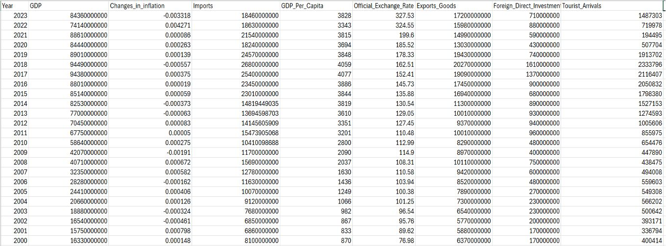
Time period
Availability of Comprehensive Data and A longer time frame allows for the identification of long-term trends and patterns in tourist arrivals.

Slide 11
Data preprocessing
1. Handling Missing Data : Imputation
2. Data Cleaning:
currency standardization
Data type alteration
cross-checking with original sources or logical consistency checks
https://macrotrends.net/global-metrics/countries/LKA/sri-lanka/inflation-rate-cpi
https://wits.worldbank.org/CountryProfile/en/Country/LKA/Year/2014/SummaryText
Validation and duplication check

Slide 12
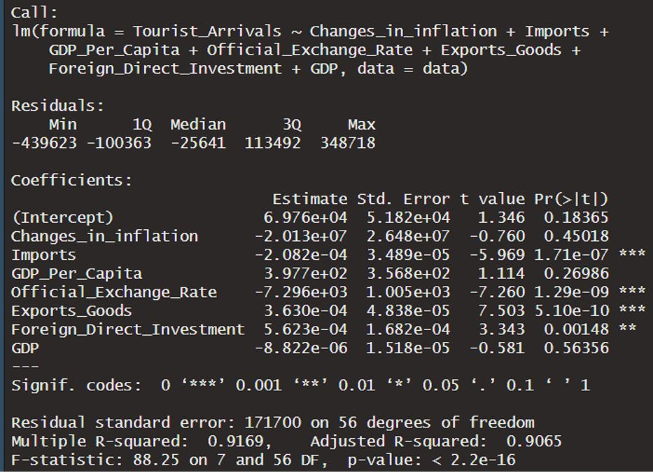
Techniques and Models
Using R we found a predictive model. where multiple linear regression model.
Imports, Official Exchange Rate, Exports Goods, and Foreign Direct Investment are significant predictors.
GDP Per Capita and GDP are not significant (p > 0.05).
predictors explain 91.57% of the variation in the dependent variable.

Slide 13
Analysis and Findings

Slide 14
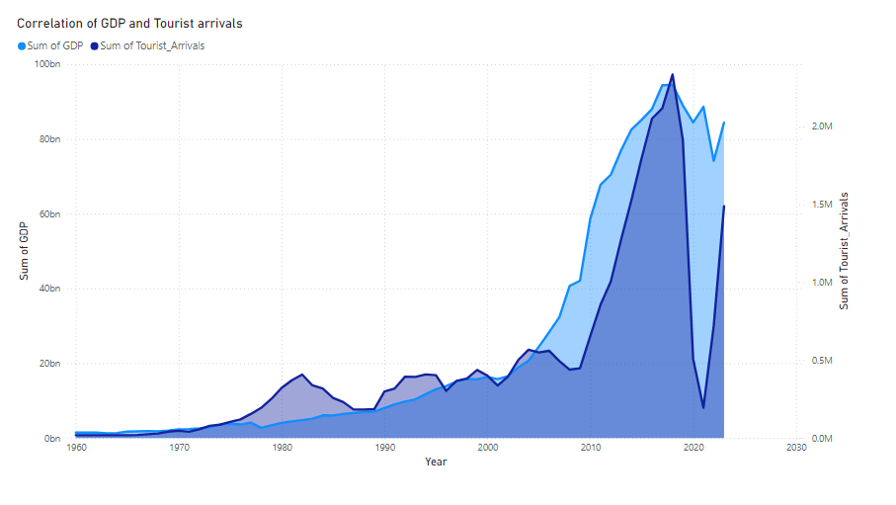

Slide 15
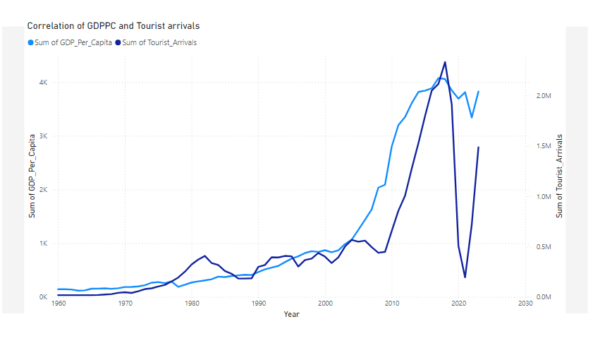

Slide 16
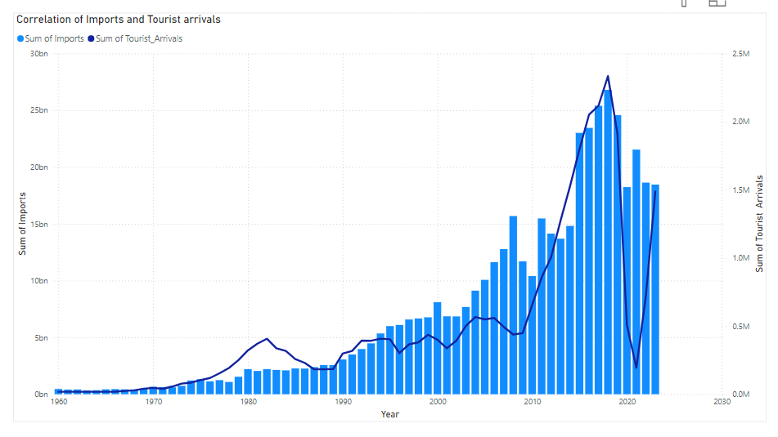

Slide 17
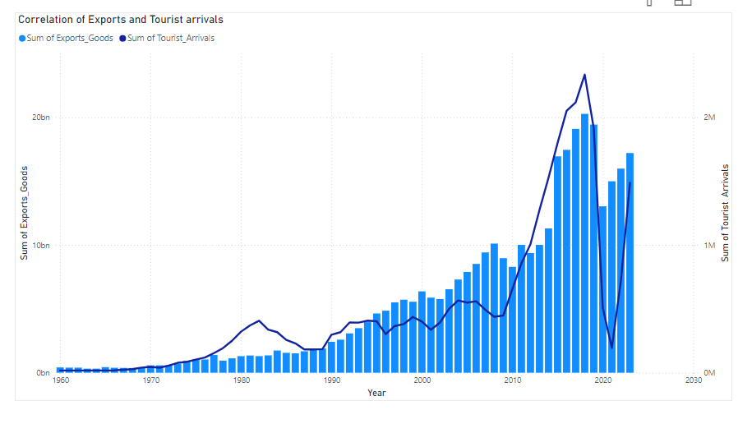

Slide 18
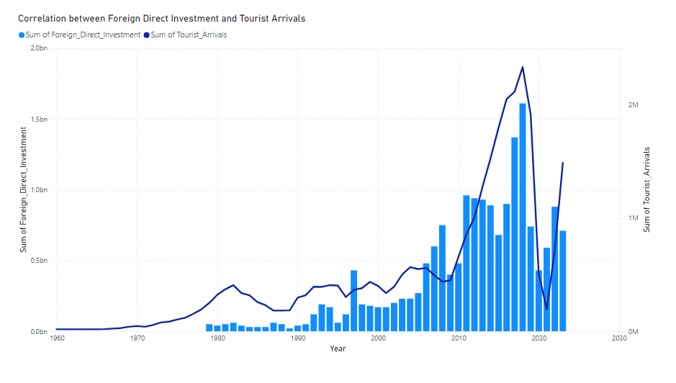

Slide 19
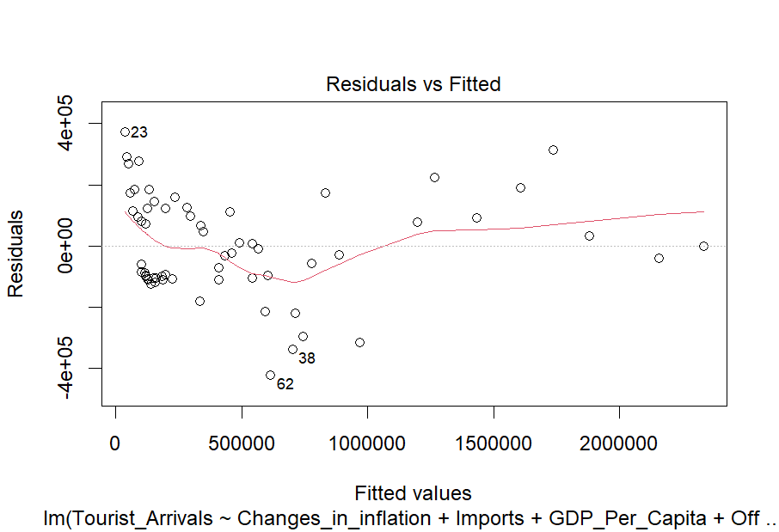

Slide 20
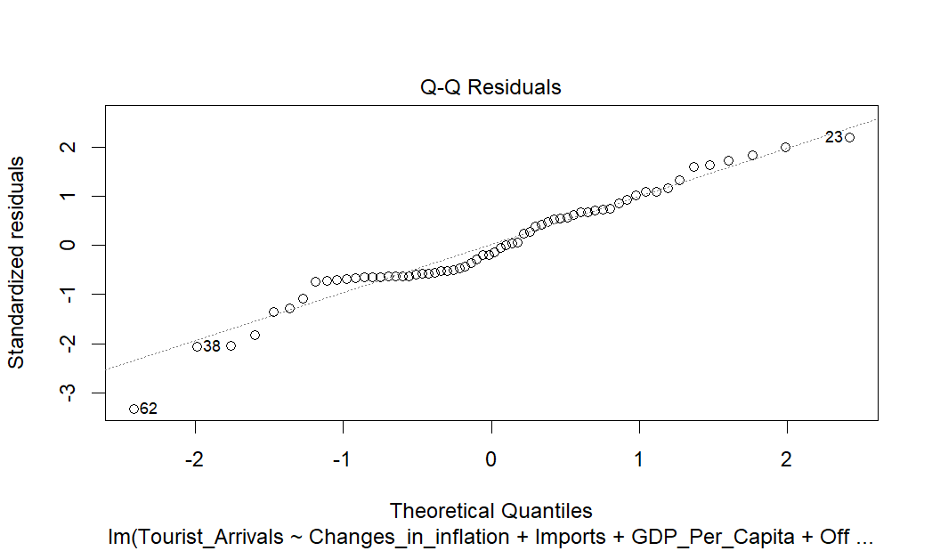

Slide 21
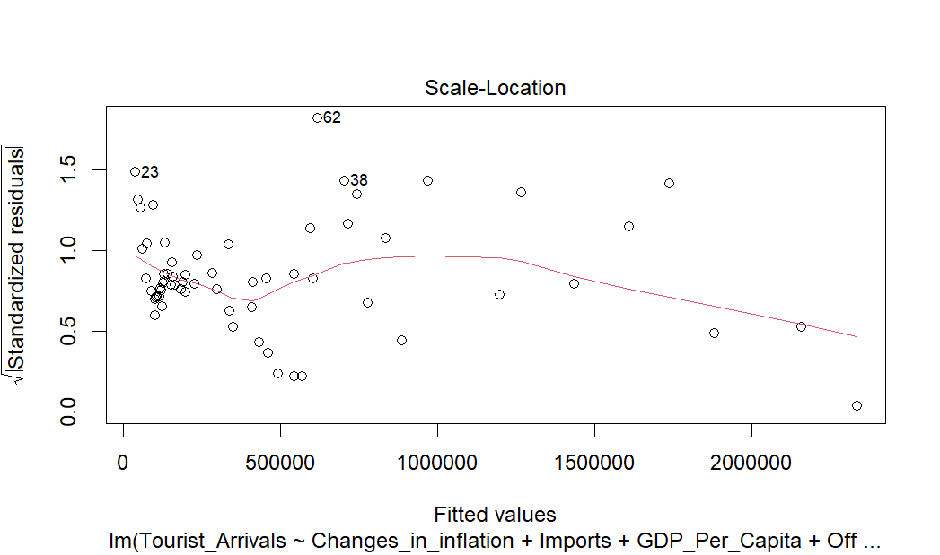

Slide 22
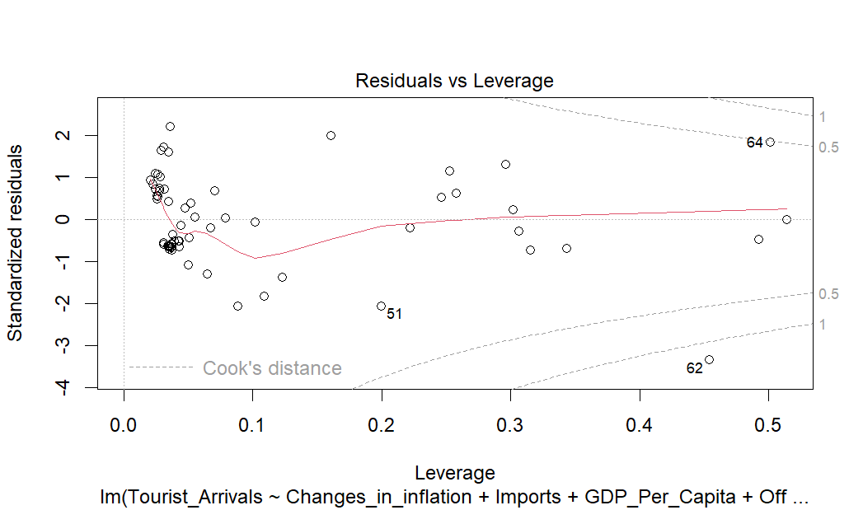

Slide 23
Recommendation
Promote Exports: Strengthen export-driven sectors that are tied to tourism, such as crafts, food, or cultural industries.
Encourage FDI: Focus on foreign investments in tourism infrastructure, such as hotels, airports, or entertainment hubs.
Monitor Exchange Rate: Stabilize or strengthen the local currency to maintain destination affordability and attractiveness.
Diversify Economy: Reduce over-reliance on imports and enhance local production to ensure economic stability that supports tourism growth.

Slide 24
Challenges and Limitaions
Data availability issues
Main objective is to evaluate Inadequate and missing macroeconomic records of the years 1960-1970 made it hard to predict trends, reducing the effectiveness of the solutions developed during this process. The lack of data can limit the ability to develop effective strategies and can give rise to false interpretations of the dataset. Without accurate and updated secondary data, it’s challenging to assess the true extent of economic factors which affect tourism. how various economic factors influence tourist arrivals in Sri Lanka, providing a comprehensive understanding of their impact on the tourism sector.
Changing requirements
To ensure the success of the project we had to gather requirements which had changing functional requirements on what our model should do and non-functional requirements such as ensuring a practical and attainable solution to our problem and how the model should perform. Therefore, we had to clearly define our objectives and prioritize the requirements of this project.

Slide 25
Importance and Future work
Importance of the study
Understanding Key Economic Drivers:
This study provides valuable insights into the economic factors that significantly influence tourism in Sri Lanka. By identifying variables such as foreign direct investment (FDI), exports, and exchange rates as critical drivers of tourism, policymakers and stakeholders can prioritize areas that maximize tourism potential.
Future work
Inclusion of Non-Economic Factors:
Future studies could expand the scope by incorporating non-economic factors such as political stability, cultural heritage, infrastructure quality, and environmental conditions to provide a holistic view of tourism determinants.
Time-Series and Causal Analysis:
A time-series analysis could examine the long-term impacts of economic factors on tourism trends. Additionally, causal models could identify whether changes in factors like FDI or exchange rates directly lead to tourism growth.

Slide 26
CONCLUSIONS
This study primarily investigated the impact of economic factors such as GDP, inflation, FDI’s, imports and exports and exchange rates to the tourist arrivals in Sri Lanka by employing correlation analysis and multiple linear regression analysis.
Based on the findings, this study concludes that economic factors have a significant impact on tourism growth in Sri Lanka. The results reveal a strong positive relationship between tourist arrivals and key economic indicators. The regression analysis suggests that exports and FDI play a crucial role in driving tourism growth in the country.
To ensure sustainable growth, the Sri Lankan government must continue fostering a favorable economic environment by encouraging FDI, improving exports, and stabilizing the exchange rate.

Slide 27
THANKS!

